Slide 1

Oroweat and vain masculinity
Erik Sundblad
Professor Sanaa Riaz
ANT/NUT 3375
8 July 2022

Slide 2

The setup
We are first introduced to the product as highlighted in the commercial
The word Healthy is featured twice and once with emphasis on the heart
The Husband is narrating with an inquisition of “…That’s the nutritious bread right?”
The point is attempting a casual setup that this bread is innately healthier

Slide 3
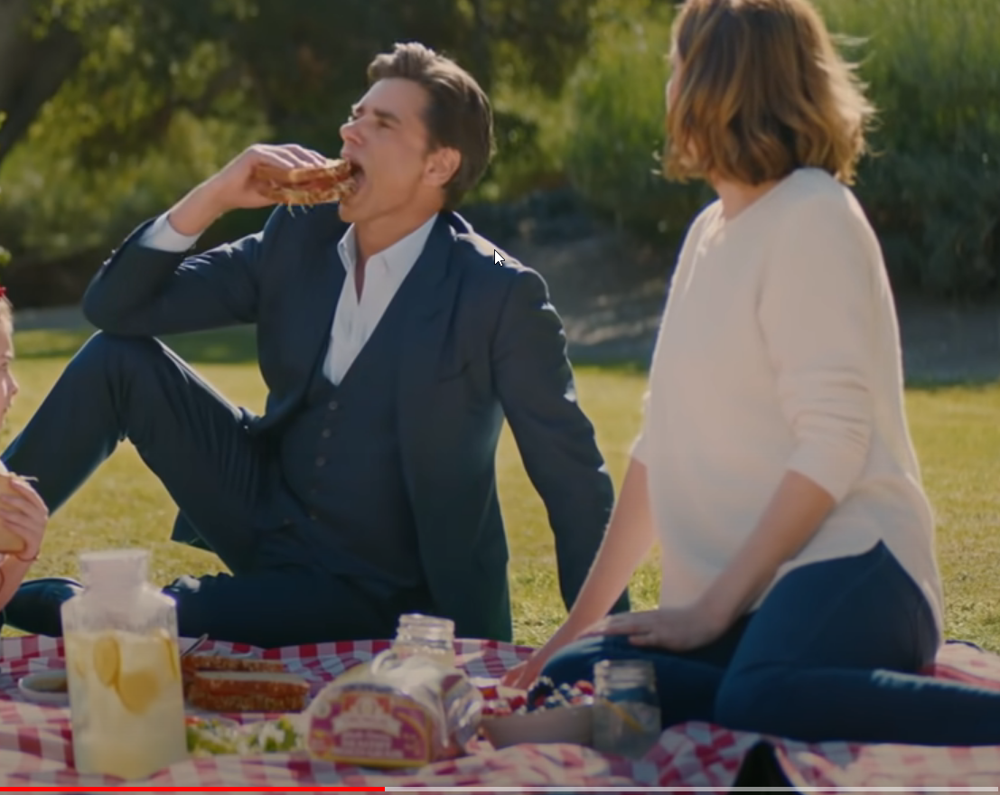
Stamos intro
The next scene, in a comic fashion John Stamos, a famous actor is slid in
Stamos makes continuing comments on the nutrition of the bread and captivates the attention of the family
He’s quoted as “eating it every day” and nonchalantly he takes a sandwich for himself
Note he’s overdressed for a park day wearing a 3 piece suite and dress shoes

Slide 4
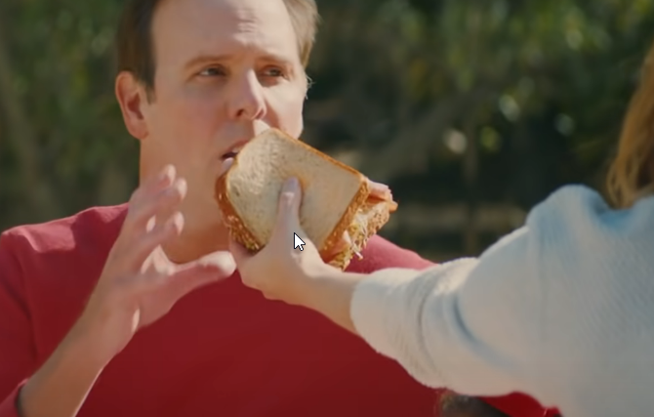
Stamos outro
This outro has Stamos sliding off with a newly acquired sandwich in hand
The father is heard commenting “that’s why he looks so good”
Followed by the wife forcing a sandwich into the father's face and saying “Eat this.”
We can note the father has thinner hair and a prominent bald spot. The clothing choice is also more casual.
The final vocals heard are the wife again saying “Yeah keep eating”

Slide 5
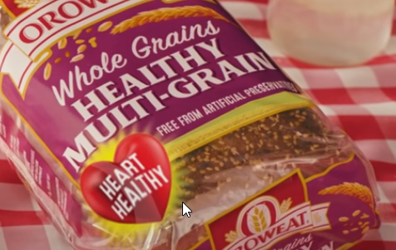
Surface Conclusion
Oroweat Bread Equals Healthy
Its on the label it must be true
The commercial hammers home this product is the “healthy”, and nutritious selection
The main Dialogue and iconography all dedicate themselves to the core narrative
No real evidence is provided for such benefits but the assumption is John Stamos says it is, so must be true

Slide 6
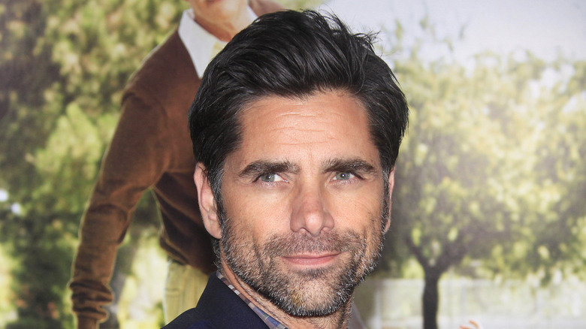
Healthy = Sexy
The underlying association is healthy is sexy
The underlying identity here is healthy food is sexy
The use of the actor John Stamos is direct iconography of male attractiveness
John Stamos is one of the most handsome Hollywood A-listers TV fans have ever come” (O’brien )

Slide 7

We go further
We contrast this with a well-tailored John Stamos
Sporting full stylized dark hair and suave demeanor
To eat healthily is to be sexier, closer to Stamos and this is desired
The family, in this commercial, is for all intent, the atomic average.
In particular the targeted contrast is between the father and Stamos
The choice of dress, highlighting thinning hair, and a non-sliming attire reflect an average apperance

Slide 8

The unattainable
The narrative continues and is strengthened by the dialogue
The father commenting on Stamos looking so good.
Immediately after we see the mother prompting him to eat the healthy bread
Even going as far as to commend the father for doing so.

Slide 9

Conclusion
Healthy food, is Sexy food!
The commercial identifies that eating healthy is the new sign of attractiveness
The comical tone of the commercial services the underlying message that the “average” case can and should pursue healthy food to be more like those we covet.
A modern switch using a male “sex symbol” but playing on vanity all the same
This commercial is one demonstration of the healthier a food is the more inherently sexy it’s consumers are.

Slide 10
Works Cited
Jennifer O’brien The Stunning Transformation Of John Stamos https://www.thelist.com/413209/the-stunning-transformation-of-john-stamos/ The List May 18, 2021
Oroweat Bread Oroweat Breads picnic with John Stamos https://www.youtube.com/watch?v=SZ7uzI1vvJI&ab_channel=OroweatBread Oroweat Bread January 4, 2022

